Slide 1
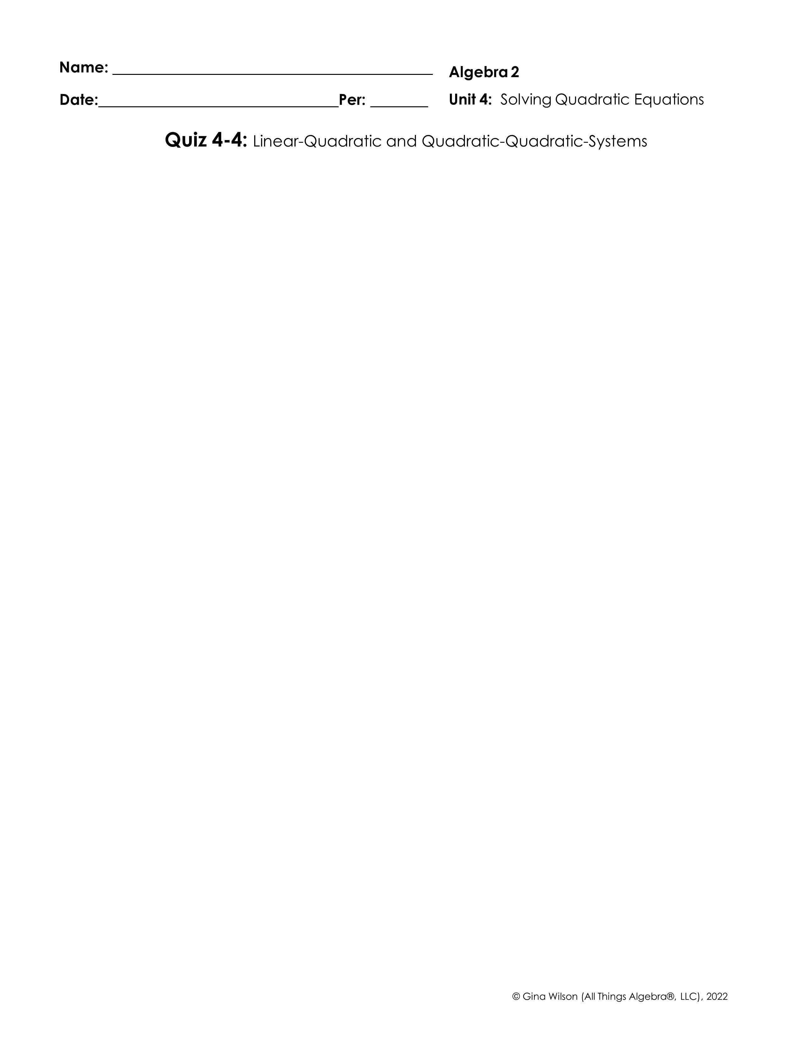
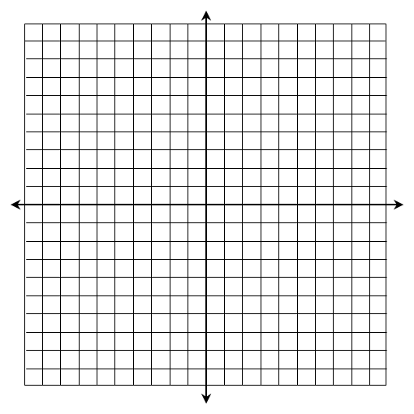
Solve by graphing:
1.
2.
Solution(s):
Solution(s):
3.
4.
Solution(s):
Solution(s):

Slide 2

Solve algebraically:
5.
6.
Solution(s):
Solution(s):
7.
8.
Solution(s):
Solution(s):

